Slide 1


Array
Fundamental Computer Programming C++
Dr. Ihsan Ullah
ihsan@saturn.yzu.edu.tw
Office: 60913

Slide 2
Set of similar variables
Suppose we want to write a program to store five students’ scores.
We may declare 5 variables.
– int score1, score2, score3, score4, score5;
What if we have 500 students? How to declare 500 variables?
Even if we have only 5, we are unable to write a loop to process them.
for (int i = 0; i < 5; i++)
{
cout << score1; // and then? cout << scorei; // error!
}

Slide 3
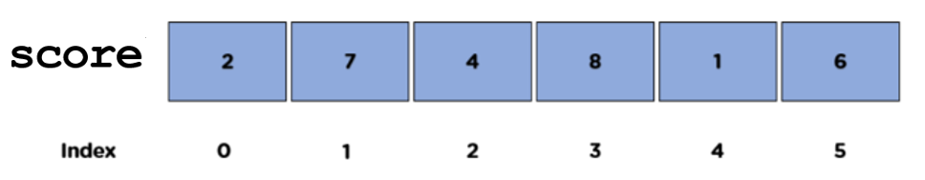
Why arrays?
An array is a collection of variables with the same type.
To declare five integer variables for scores, we may write:
int [5];
These variables are declared with the same array name (score).
They are distinguished by their indices.
cout << score[2];

Slide 4
An array is a type
Arrays are often used with loops.
– Quite often the loop counter is used as the array index.
int score[5];
for (int i = 0; i < 5; i++) cin >> score[i];
for (int i = 0; i < 5; i++) cout << score[i] << " ";
An array is also a (nonbasic) type.
The type of score is an “integer array” (of length 5).
What is this?
cout << score;
We will go back to this when we introduce pointers.
– For now, just treat an array as a sequence of variables.

Slide 5
Array declaration
The grammar for declaring an array is
Address
Identifier
Value
0x20c648 | score[0] | ?
0x20c64c | score[1] | ?
0x20c650 | score[2] | ?
0x20c654 | score[3] | ?
0x20c658 | score[4] | ?
data type array name[number of elements];
E.g., int score[5];
This is an integer array with five elements (the
array length/size is 5).
Each array element itself is a variable.
The index starts at 0! They are score[0], score[1], …, and score[4].
It occupies 4 bytes * 5 = 20 continuous bytes.
Try cout << sizeof(score);!
Memory

Slide 6
An example
We have written a program for 5 scores:
int score[5];
for (int i = 0; i < 5; i++) cin >> score[i];
for (int i = 0; i < 5; i++) cout << score[i] << " ";
If we have 500 students:
int score[500];
for (int i = 0; i < 500; i++) cin >> score[i];
for (int i = 0; i < 500; i++) cout << score[i] << " ";

Slide 7
Array initialization
Arrays are not initialized automatically.
int array[100];
for (int i = 0; i < 100; i++)
{
cout << array[i] << " "; if (i % 10 == 9)
cout << "\n";
}

Slide 8
Array initialization
Various ways of initializing an array:
– int dayInMonth[12] = {31, 28, 31, 30, 31, 30, 31, 31, 30,
31, 30, 31};
– int dayInMonth[] = {31, 28, 31, 30, 31, 30, 31, 31, 30, 31,
30, 31}; (size of dayInMonth will be 12)
– int dayInMonth[12] = {31, 28, 31}; (nine 0s)
int dayInMonth[3] = {1, 2, 3, 4}; (error!)
string cars[4] = {"Volvo", "BMW", "Ford", "Mazda"};
To initialize all elements to 0:
int score[500] = {0}; (500 0s)

Slide 9
Array initialization
string cars[4] = {"Volvo", "BMW", "Ford", "Mazda"};OR
string cars[] = {"Volvo", "BMW", "Ford", "Mazda"};
Print array element:
cout << cars[0];
Change the array element:
cars[0] = "Opel"; cout << cars[0];
#include <iostream>
#include <string>
using namespace std;
int main() {
string cars[4] = {"Volvo", "BMW", "Ford", "Mazda" };
for (int i = 0; i < 4; i++) {
cout << cars[i] << "\n";
}
return 0;
}

Slide 10
The boundary of an array
In C++, it is allowed for one to “go outside an array”.
No compilation error!
May or may not generate a run time error: If our program try to access a memory space allocated to another program, the operating system will terminate our program.
The result is unpredictable.
A programmer must be aware of array bounds by herself/himself.
int array[100] = {0};
for (int i = 0; i < 500; i++)
{
cout << array[i] << " "; if (i % 10 == 9)
cout << "\n";
}

Slide 11
Memory allocation for arrays
So what happens when we declare or access an array?
When we declare an array:
Address
Identifier
Value
0x20c648 | score | ?
0x20c64c |  | ?
0x20c650 |  | ?
0x20c654 |  | ?
0x20c658 |  | ?
int score[5];
The system allocates memory spaces according to the type and length.
The array variable indicates the
beginning address of the space.
cout << score; // 0x20c648
Memory

Slide 12
Memory indexing for arrays
When we access an array element:
The array index indicates the amount of
offset for accessing a memory space.
score[i] means to take the variable stored at “starting from score, offset by i units”.
cout << score + 2; // 0x20c650
So score[i] is always accepted by the compiler for any value of i.
Always be careful when using arrays!
Address
Identifier
Value
0x20c648 | score | ?
0x20c64c |  | ?
0x20c650 |  | ?
0x20c654 |  | ?
0x20c658 |  | ?
Memory

Slide 13
Finding the array length
Sometimes we are given an array whose size is not known by us.
One way of finding the array length is to use sizeof.
It returns the total number of bytes allocated to that array.
Suppose the array is named score, its length equals
sizeof(score) / sizeof(score[0]);
sizeof(score) is the total number of bytes allocated to the array.
sizeof(score[0]) is the number of bytes allocated to the first element.

Slide 14
Example: finding the maximum
How to find the maximum among many numbers?
Suppose we want to write a program that:
Asks the user to input 10 numbers.
Once 10 numbers are input, prints out the maximum.
float value[10] = {0};
for (int i = 0; i < 10; i++) cin >> value[i];
// and then?

Slide 15
Example: finding the maximum
One pseudocode for finding the • Implementation: maximum in a set is:
Given a vector A of n numbers:
for i from 0 to n – 1
find the larger between A_{i} and A_{i + 1}
put the larger one at A_{i + 1}
// value: a size-10 float array for (int i = 0; i < 9; i++)
{
if (value[i] > value [i + 1])
output A_{n}
{
float temp = value[i + 1]; value[i + 1] = value[i]; value[i] = temp;
What some drawbacks of this implementation (or algorithm)?
}
}
cout << value[9];

Slide 16
Example: finding the maximum
Let’s record the current maximum at some other place:
float value[10] = {0};
for (int i = 0; i < 10; i++) cin >> value[i];
float max = value[0];
for (int i = 1; i < 10; i++)
{
if (value[i] > max) max = value[i];
}
cout << max;

Slide 17
Things you cannot (should not) do
Although allowed in Dev-C++, you should not declare an array with its length being a nonconstant variable.
This creates a syntax error in some compilers.
In ANSI C++, the length of an array must be
fixed when it is declared.
To dynamically determine the array length:
The index of an array variable should be an
integer.
Some compiler allows a fractional index (casting is done automatically).
// DO NOT do this int x = 0;
cin >> x;
// very bad! int array[x];
array[2] = 3; // etc.
// Do this int x = 0; cin >> x;
// good!
int* array = new int[x]; array[2] = 3; // etc.

Slide 18
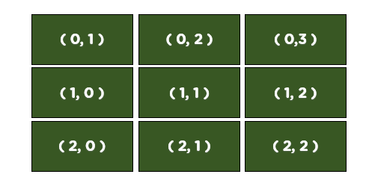
Two-dimensional arrays
While a one-dimensional array is like a vector, a two-dimensional array is like a
matrix or table.
Intuitively, a two-dimensional array is composed by rows and columns.
– To declare a two-dimensional array, we should specify the numbers of rows and columns.
data type array name[rows][columns];
As an example, let’s declare an array with 3 rows and 3 columns.
double score[3][3];

Slide 19
Two-dimensional arrays
double score[3][7];
0 1 2 3
4
5
6
0
1
2
– score[0][0] is the 1st and score[0][1] is the 2nd. What are x and y?
We may initialize a two-dimensional array as follows:
– int score[2][3] = {{4, 5, 6}, {7, 8, 9}};
– int score[2][3] = {4, 5, 6, 7, 8, 9}; // 2 can be omitted.
[0][0] | [0][1] | [0][2]
[1][0] |  |  |  | [x][y]
[2][0]

Slide 20
Example: matrix addition
Let’s write a program to do matrix addition.
int a[2][3] = {{1, 2, 3}, {1, 2, 3}};
int b[2][3] = {{4, 5, 6}, {7, 8, 9}}; int c[2][3] = {0};
for (int i = 0; i < 2; i++)
{
for (int j = 0; j < 3; j++) c[i][j] = a[i][j] + b[i][j];
}

Slide 21
Embedded one-dimensional arrays
Two-dimensional arrays are not actually rows and columns.
A two-dimensional array is actually several one-dimensional arrays.
0 1 2 3 4 5 6
score[0]
score[1] score[2]
[0][0] | [0][1] | [0][2]
[1][0]
[2][0]
Try this:
int a[2][3];
cout << a << " " << a[0] << " " << a[1] << endl;

Slide 22
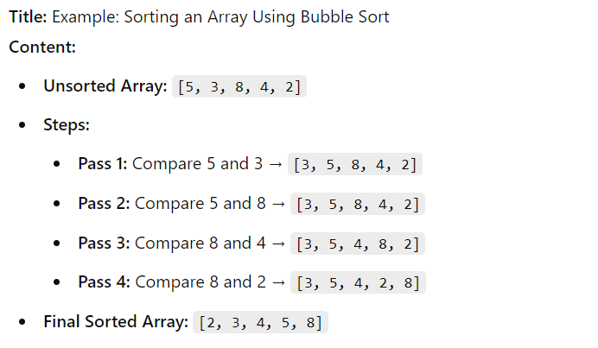
Soring Array:
What is Sorting? Sorting is the process of arranging elements in a particular order (ascending or descending).
Sorting an Array Using Bubble Sort

Slide 23
Two Dimensional of string
#include <iostream>
#include <string>
using namespace std;
int main() {
string letters[2][4] = {
{ "A", "B", "C", "D" },
{ "E", "F", "G", "H" }
};
for (int i = 0; i < 2; i++) {
for (int j = 0; j < 4; j++) {
cout << letters[i][j] << " ";
}
cout << endl;}
return 0;
}
string letters[2][4] = { { "A", "B", "C", "D" }, { "E", "F", "G", "H" } };.

Slide 24
Access the elements of 2-D Array
string letters[2][4] = {
{ "A", "B", "C", "D" },
{ "E", "F", "G", "H" }
};
cout << letters[0][2];
// Outputs "C"
string letters[2][4] = {
{ "A", "B", "C", "D" },
{ "E", "F", "G", "H" }
};
letters[0][0] = "Z";
cout << letters[0][0]; // Now outputs "Z" instead of "A"

Slide 25
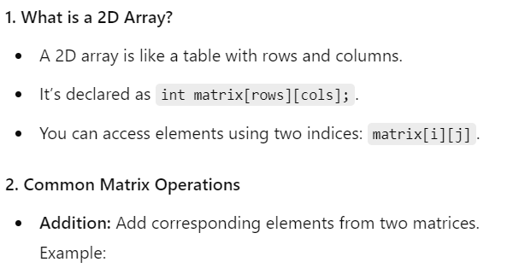
Access the elements of 2-D Array

Slide 26
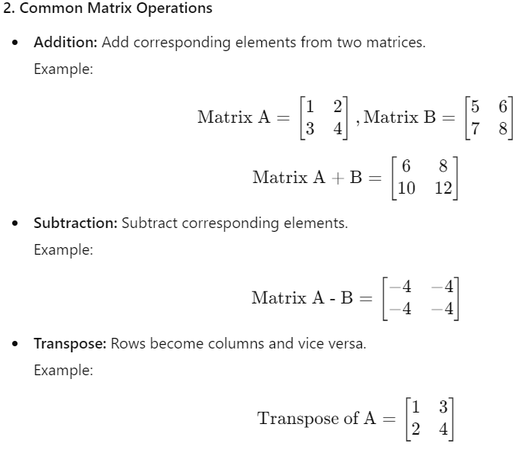
Access the elements of 2-D Array

Slide 27
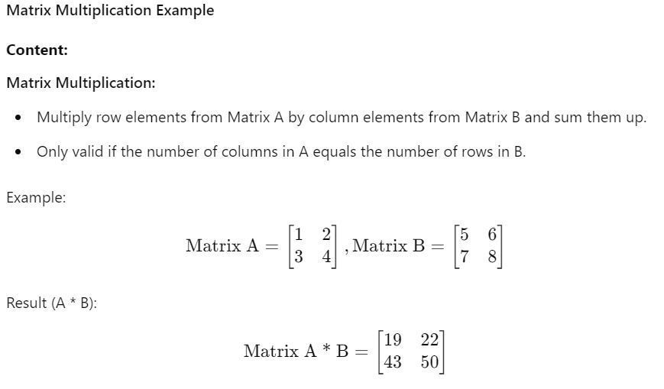
Access the elements of 2-D Array

Slide 28
Assignment:
Assignment 1: Implement a Simple ATM System
Requirements:
The user starts with an initial balance of $1000.
Display a menu of options
Check Balance
Deposit Money
Withdraw Money
Exit
Assignment 2: Sorting an Array of Integers:
Requirements:
Define an array of 10 integers.
Use a for-loop to take input from the user.
Implement the Bubble Sort algorithm to sort the array.
Display the sorted array after sorting.
Assignment 3: Matrix Operations
Requirements:
Input two matrices (2D arrays) of size N x M.
Perform the following matrix operations:
Addition of the two matrices.
Subtraction of the two matrices.
Multiplication of the two matrices.
Transpose of a matrix.
Display the result of each operation.

Slide 29
Assignment:
Assignment 2
Assignment 1
Enter 10 integers:
34 12 5 67 89 23 56 78 45 9
Array after sorting:
5 9 12 23 34 45 56 67 78 89
Welcome to the ATM System!
1. Check Balance
2. Deposit Money
3. Withdraw Money
4. Exit
Enter your choice: 1
Your balance is: $1000
Enter your choice: 2
Enter the amount to deposit: 500
Your new balance is: $1500
Enter your choice: 3
Enter the amount to withdraw: 200
Your new balance is: $1300
Enter your choice: 4
Exiting the system...
Assignment 3

